Slide 1
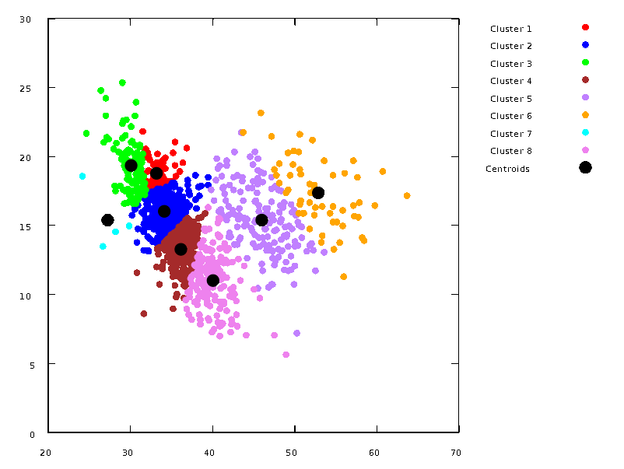
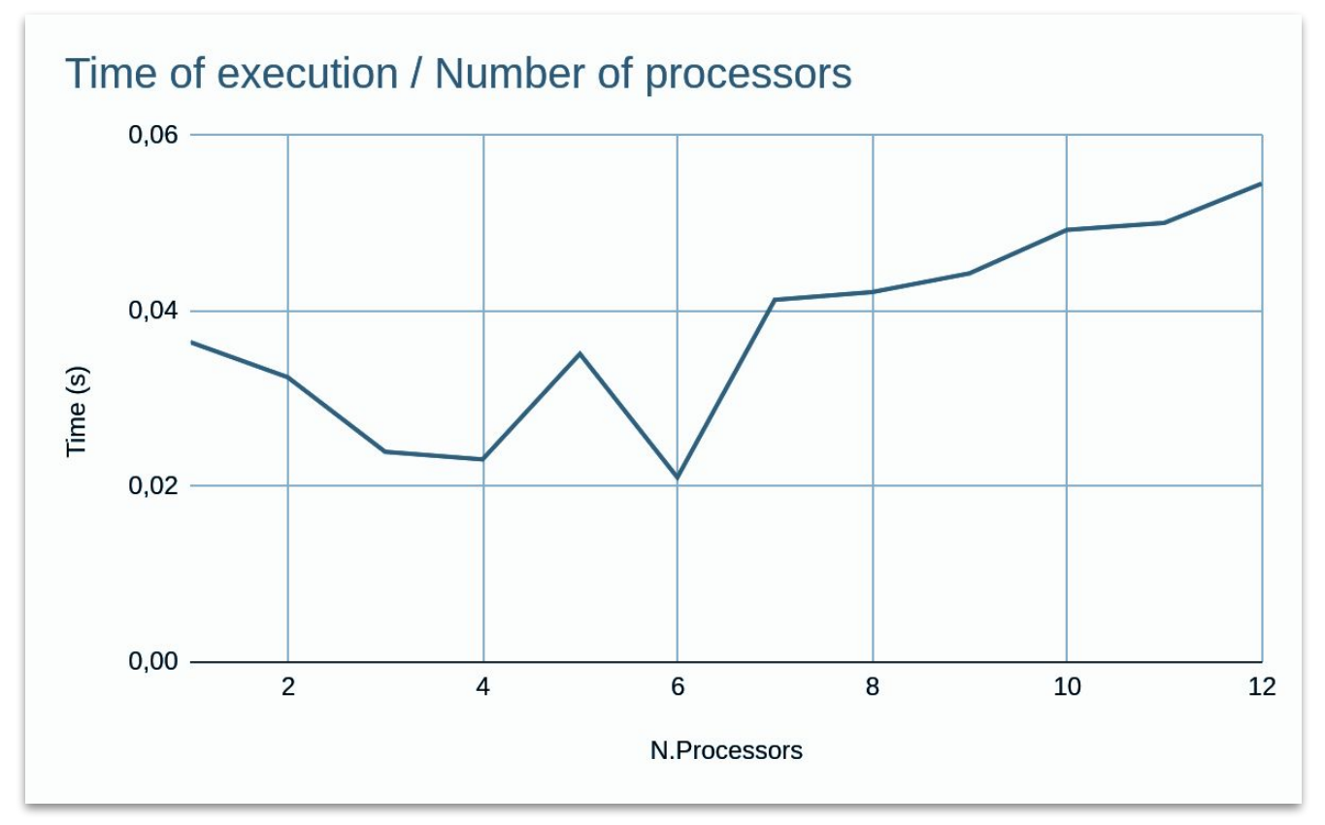

Where we left off…
Very inefficient implementation of kmeans using mpi with the following problems:
Too high occupancy of RAM during the execution (all the processors were saving the whole dataset and managing only a part of the points)
A lot of send and recieve made the code as fast as the sequential implementation
We stopped believing in parallel computing…

Slide 2

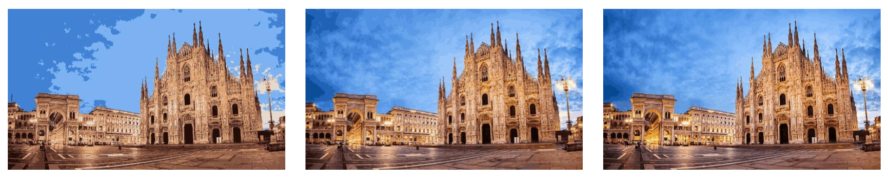
Parallel Kmeans-based Image Compressor
Francesco Rosnati
Leonardo Ignazio Pagliochini
Image quantization by kmeans clustering on different parallel frameworks

Slide 3
Table Of Contents
Image Quantization
Program Structure
Code Overview
Performance Evaluation
Compression Results

Slide 4
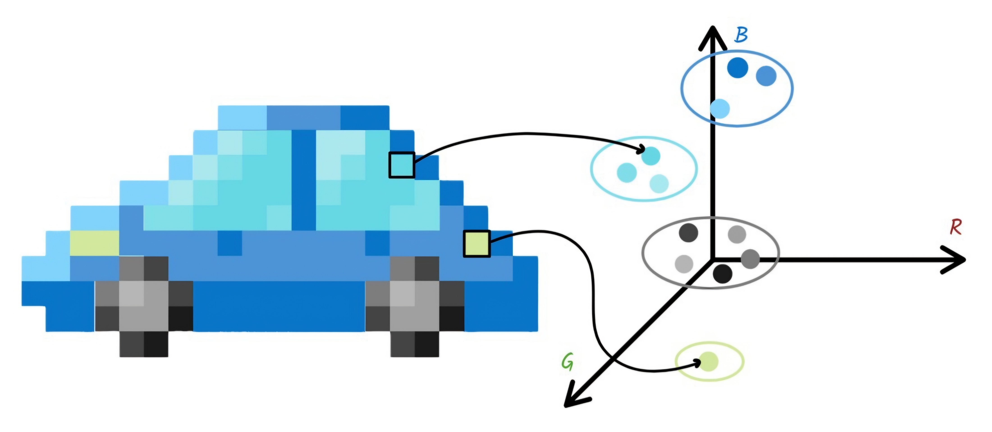
Image Quantization
Multidimensional color decomposition
Clustering colors by kmeans
How is the compression achieved?
The importance of color model choice

Slide 5



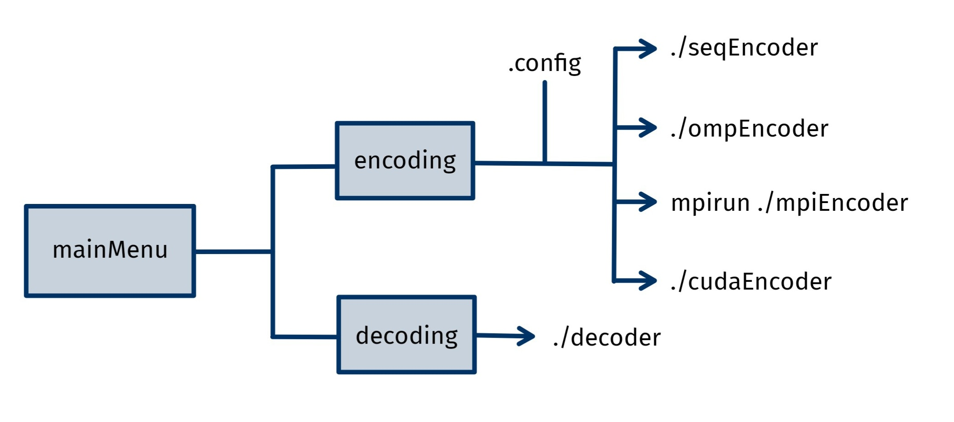

Program Structure
ENCODER
Manage encoders execution through boost/process
Usage flexibility: the configReader class
lena.kc
configReader
- std::regex pattern{} - std::unordered_set<std::string> required_variables …
+ ConfigReader() + auto checkVariableExists(variableName) -> bool + auto readConfigFile() -> bool …
DECODER

Slide 6
Code Overview
kMeansCUDA
kMeansCUDA(k, points) run() getPoints() getCentroids() getIterations()
kMeansSequential
kMeansSequential(k, points) run()
kMeansSequential
kMeansBase
kMeansBase(k, points) kMeansBase(k) run() getPoints() getCentroids() getIterations()
kMeansOMP
kMeansBase
kMeansOMP
kMeansOMP(k, points) run()
kMeansMPI
virtual
kMeansCUDA
__global__ void calculate_new_centroids(*data, *centroids, *lables, *counts, n, k, dim) __global__ void average_centroids(*centroids, *counts, k, dim) __global__ void assign_clusters(*data, *centroids, *labels, n, k, dim )
kMeansMPI
kMeansMPI(k, points, local_points) kMeansMPI(k, local_points) run()

Slide 7


Code Overview: OpenMP
Assigment of each point is independent
Assign to clusters
Possibility of massive parallelism
Compute partial sums
Operations over each cluster are independent
Limited number of CPU cores
Balance workload over each thread
New centroids

Slide 8
Code Overview: CUDA
SIMD
Assign to clusters
__global__ void assign_clusters(*data, *centroids, *labels, n, k, dim )
Comutepartil sums
Compute partial sums
__global__ void average_centroids(*centroids, *counts, k, dim)
SIMT
__global__ void calculate_new_centroids(*data, *centroids, *lables, *counts, n, k, dim)
New centroids
New centroids

Slide 9

Code Overview: MPI
Encoder MPI
P[0]
MPI_BCAST
P[1]
P[2]
(k, n_points)
MPI_SEND
P[3]
P[4]
P[5]
P[6]
P[0]
Points
Local Points

Slide 10
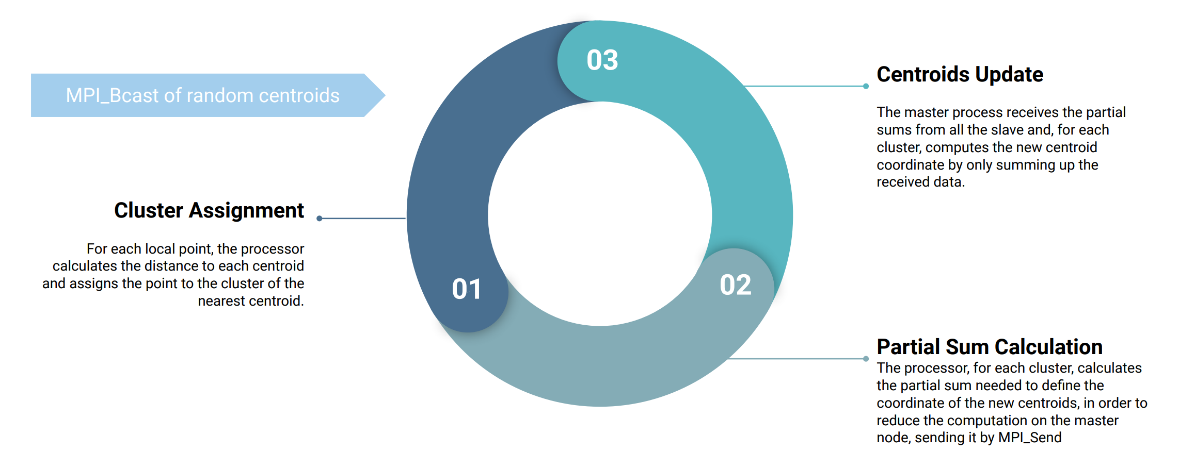
Code Overview: MPI
KmeansMPI::run()
P[1]
P[2]
P[3]
P[4]
MPI_Send
P[0]

Slide 11
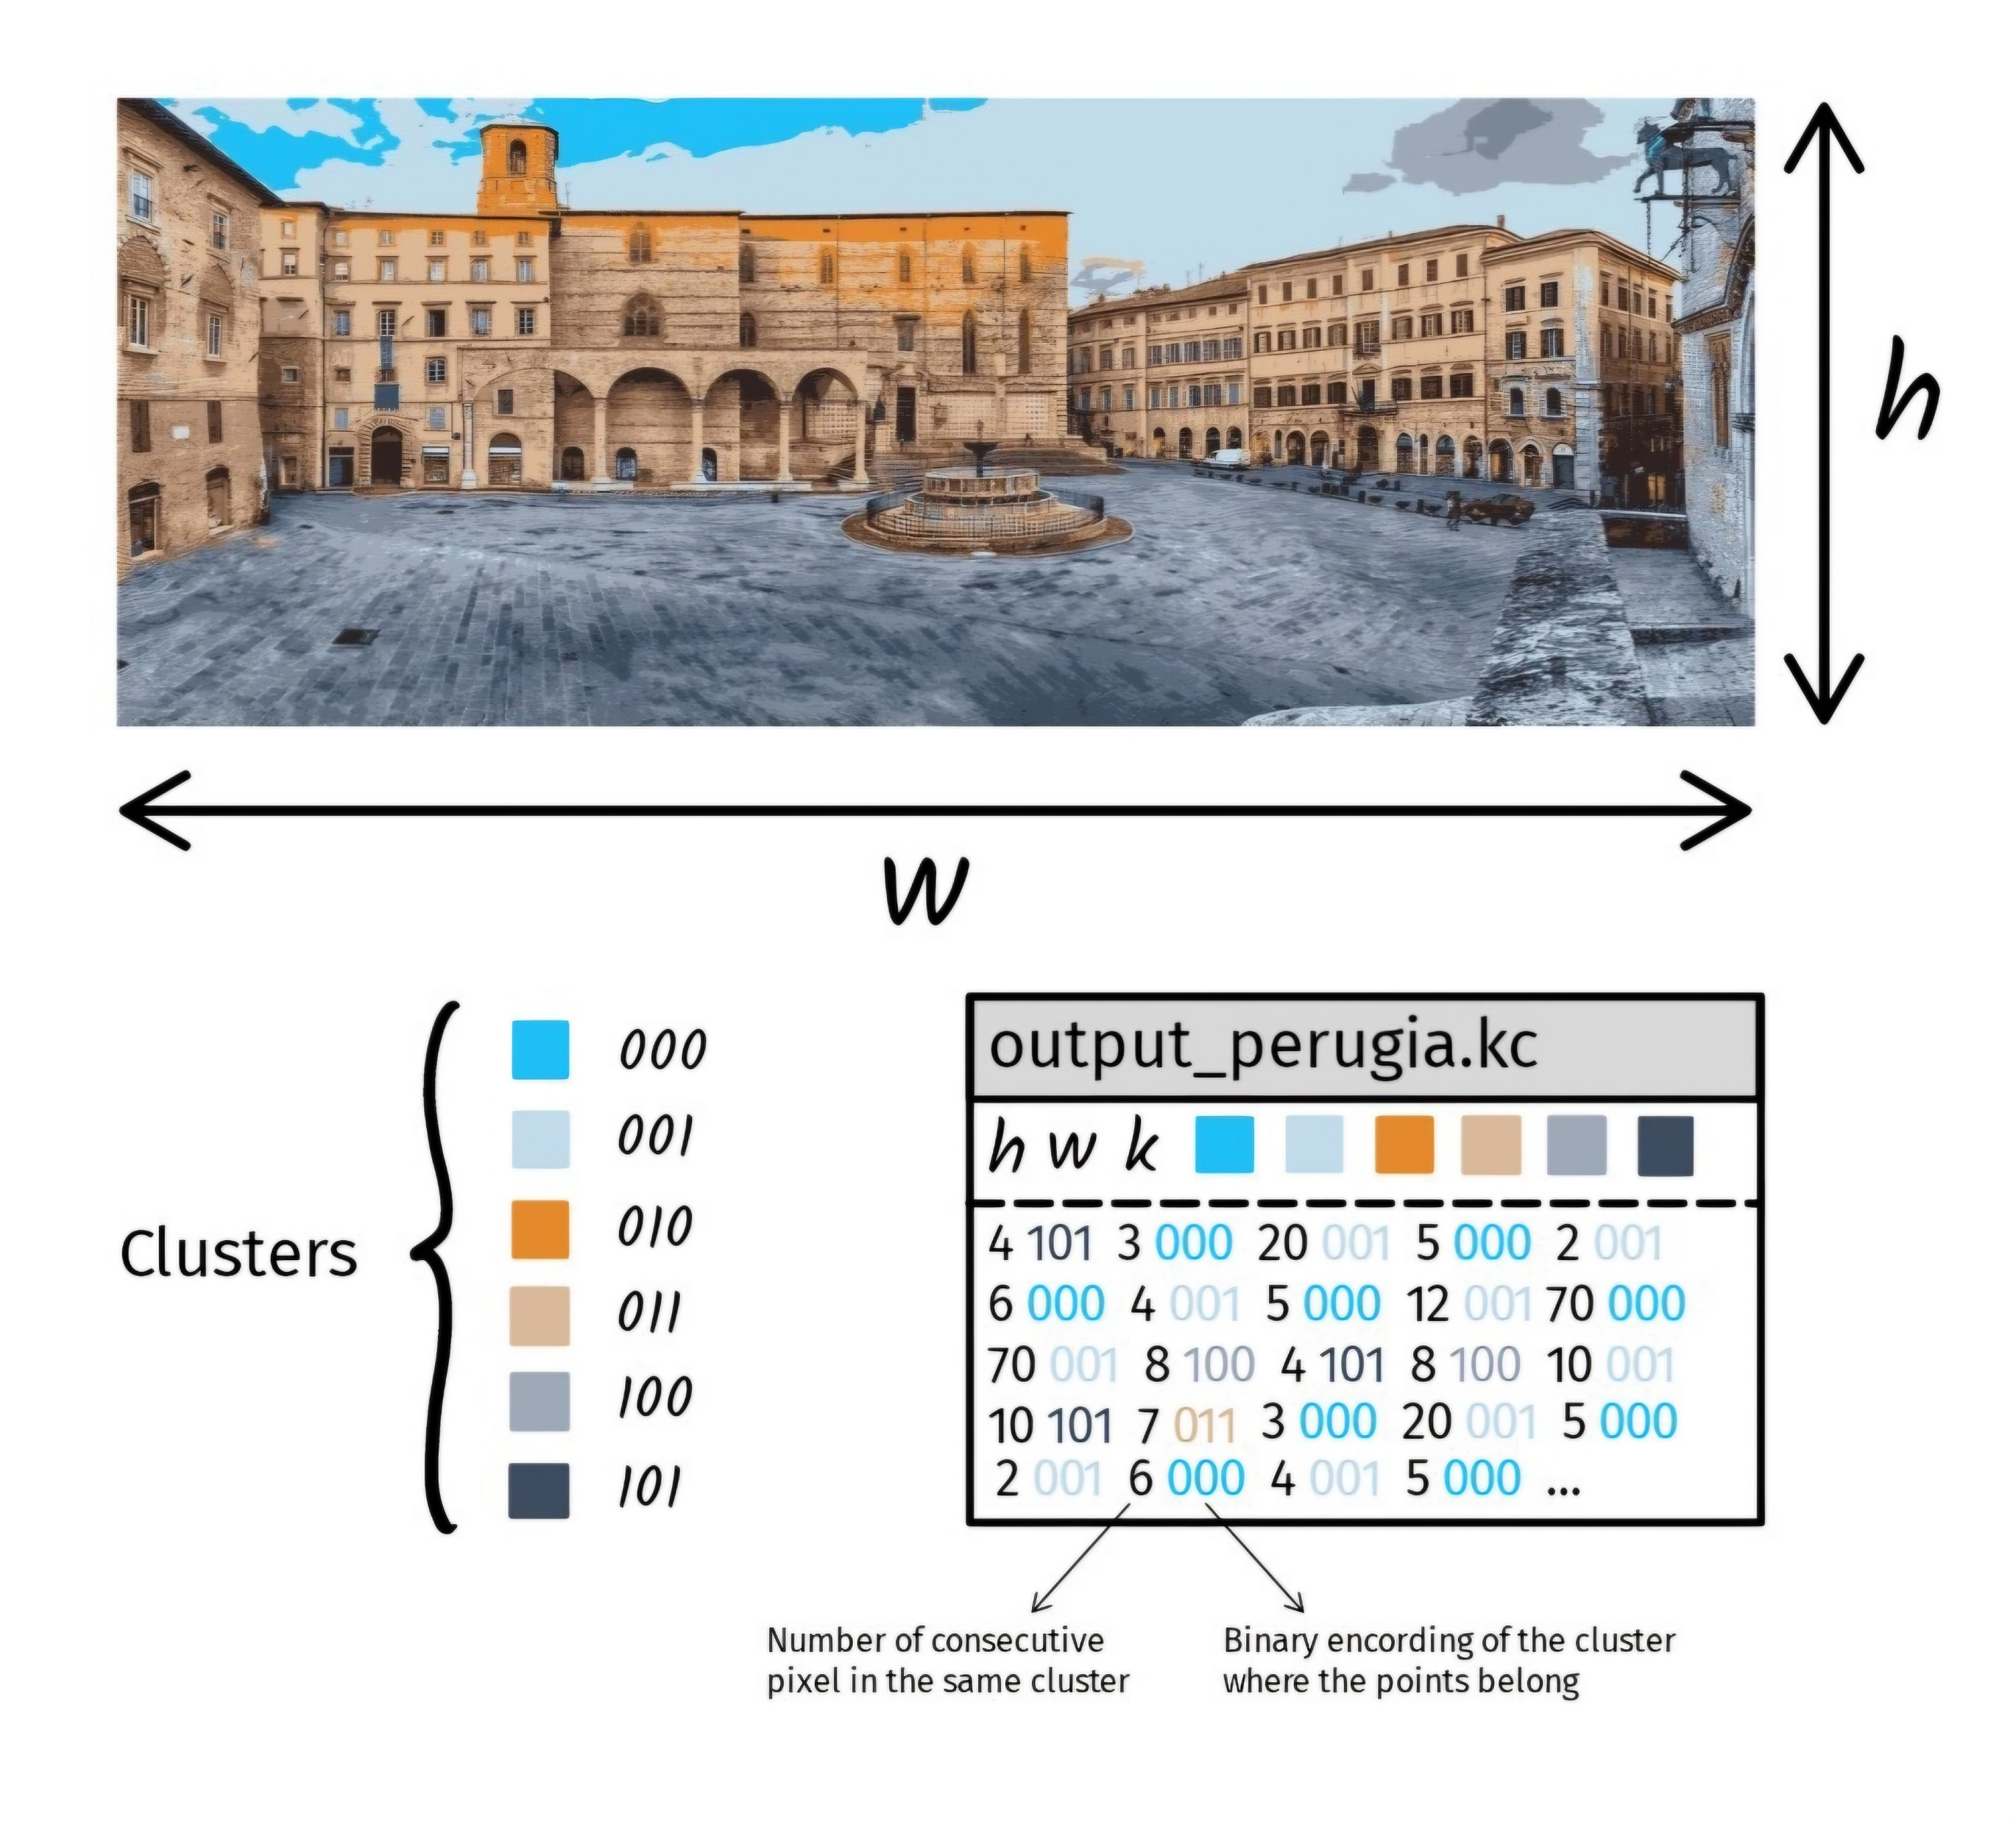
Binary Encoding
Metadata at the beginning of the file
RLE technique used to encode information about the pixels’ membership.
Design choice: Both the number of clusters and the number of consecutive pixels that can be encoded are bounded by 256

Slide 12
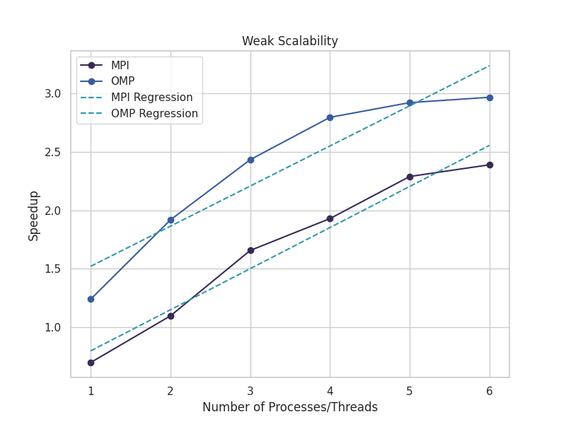
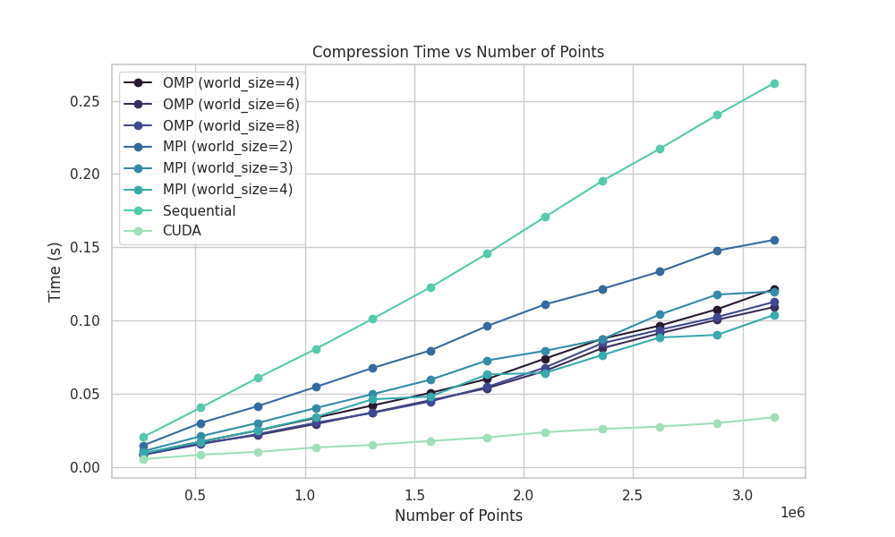
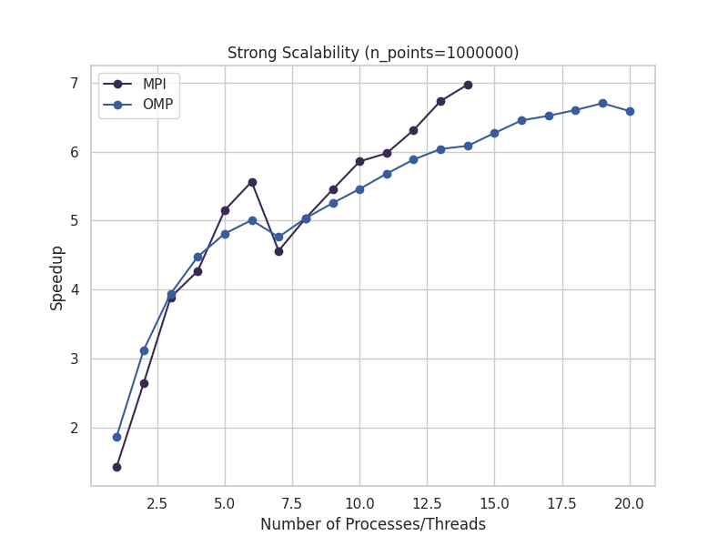
Performance Evaluation

Slide 13
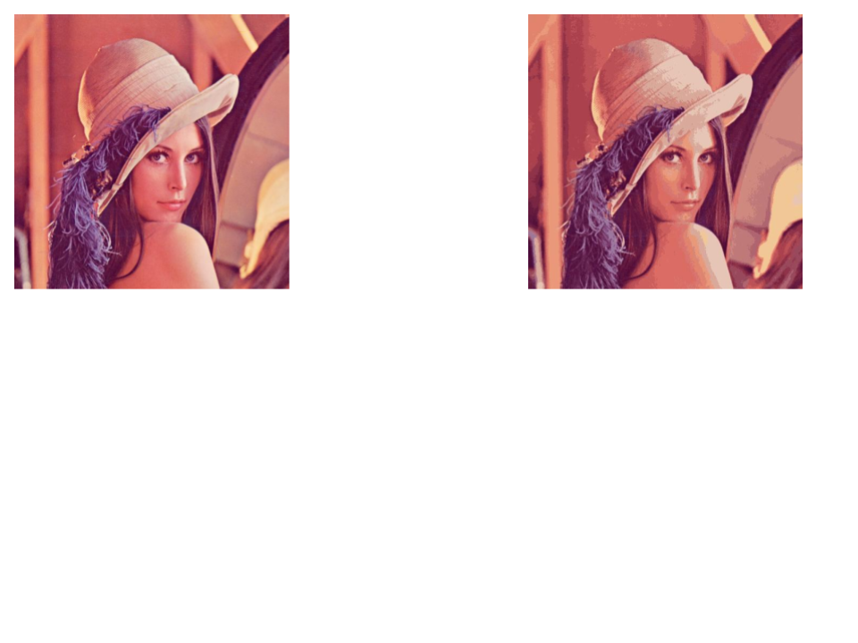
Compression Results
To conclude our presentation…
748 KB
???
323 KB
154 KB
154 KB
217 KB
27 KB

Slide 14
Thank you for the attention

